Slide 1


LocalLink: Smart Local Services Platform
School: RV University
Presentation By:
Name1: Aneesh Adithya SR USN1:1RVU23CSE054
Name2: Varun U Badiger USN2:1RVU23CSE530
Name3: Pratham RD USN3:1RVU23CSE348
Name4:Rajath D Kudur USN4:1RVU23CSE366

Slide 2
AGENDA
Introduction
Git and Version Control
UML Diagrams
Frontend Design
Database Schema
Backend & API Integration
Testing Framework
Hosting the Web Application
Conclusion

Slide 3
INTRODUCTION
LocalLink is a full-stack web platform that connects customers with nearby service providers such as electricians, plumbers, and cleaners. It includes user roles (customer, provider, admin), booking, complaint, and rating systems. The app uses Flask for backend, SQLAlchemy for database management, HTML/CSS/JS for frontend, and is deployed live on Render cloud.

Slide 4
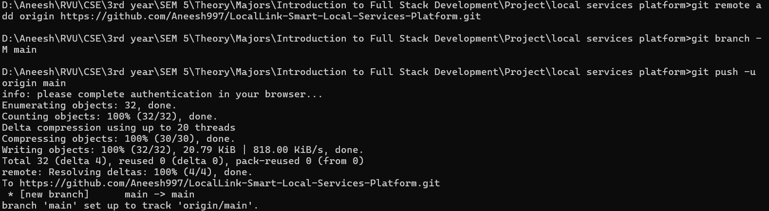
Git and Version Control
Git was used for version control and collaboration. Every feature update or bug fix was committed and pushed to GitHub, maintaining a clean development history. Branches helped separate testing and deployment versions. Git ensured backup, easy rollback, and team coordination throughout the project lifecycle.

Slide 5
UML Diagrams
UML diagrams were created to visualize system behavior and structure.
Use Case Diagram shows interactions between users and the system.
Class Diagram represents relationships among User, Service, Booking, Complaint, and Chat classes.
Sequence Diagram explains data flow during booking and communication.
These diagrams provide a clear understanding of the architecture before coding.

Slide 6
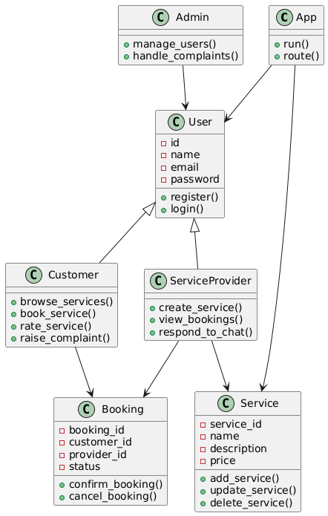
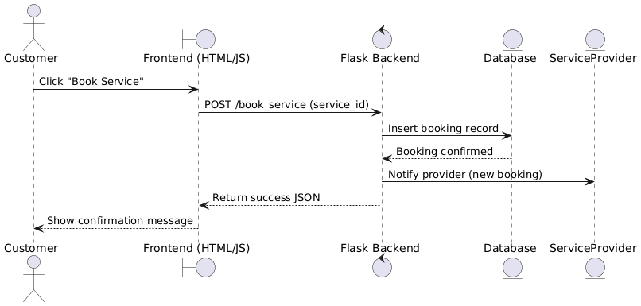
Class Diagram (Backend structure — Flask + Models)
Sequence Diagram (Booking Flow)

Slide 7
Use Case Diagram (High-level system view)

Slide 8
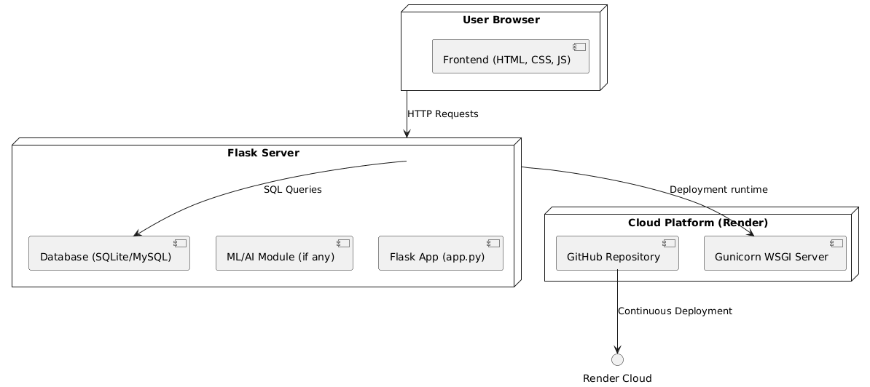
Deployment Diagram

Slide 9
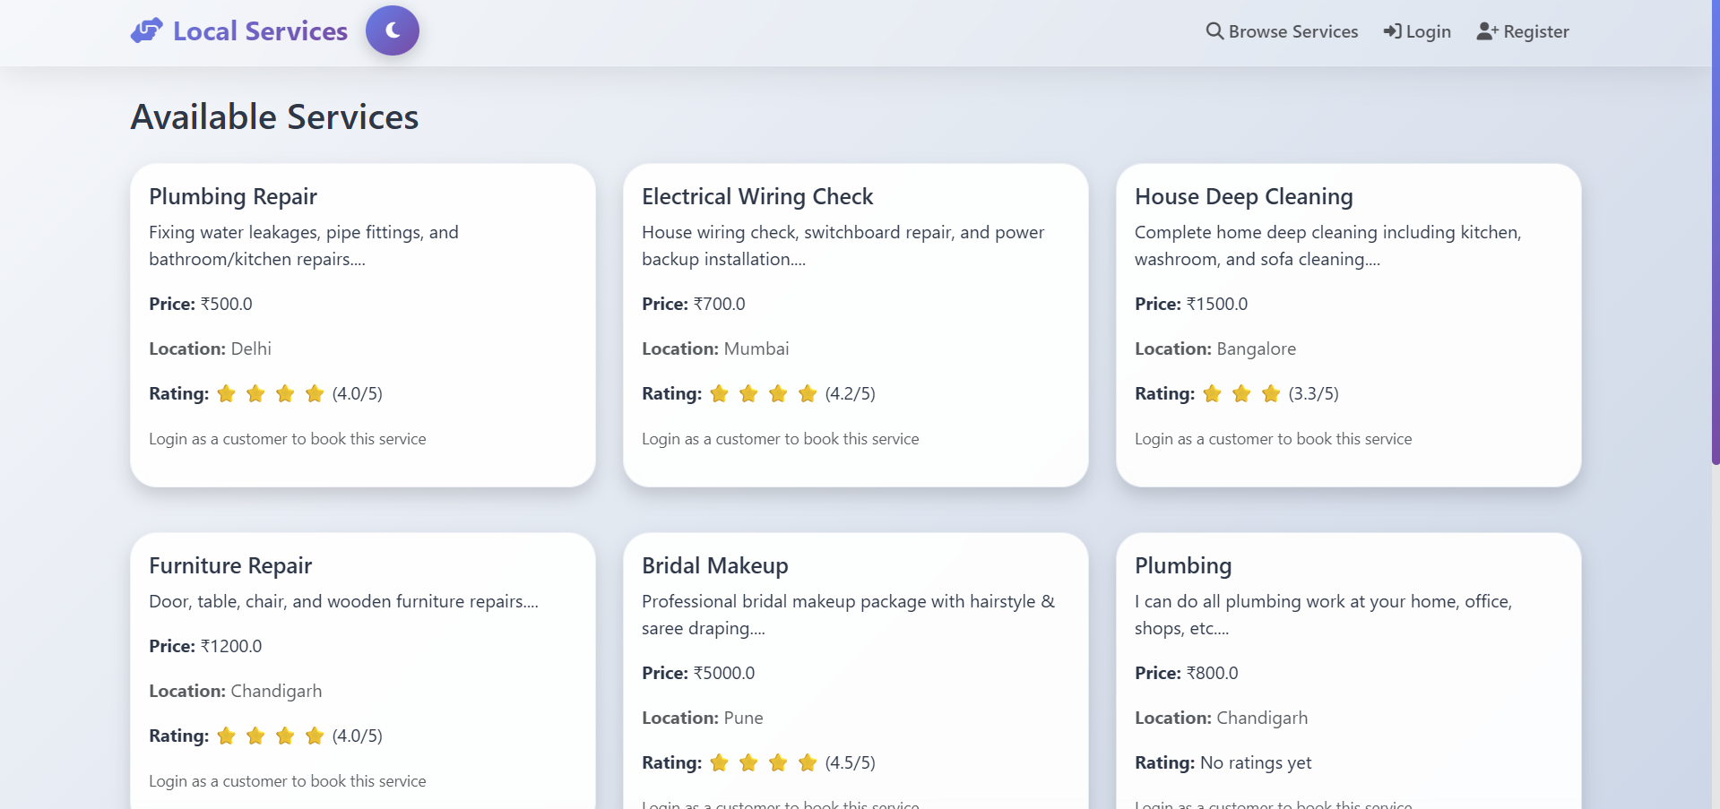
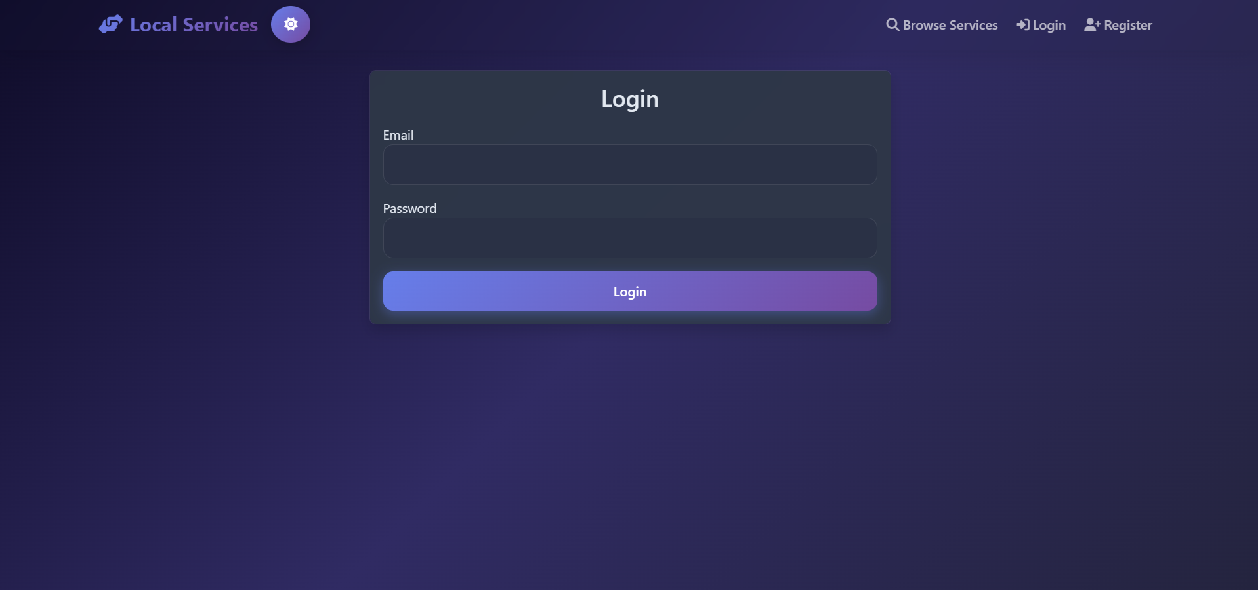
Frontend Design
The frontend was built using HTML5, CSS3, JavaScript, and Bootstrap 5 for responsiveness. Templates were rendered via Flask’s Jinja2 engine. The interface includes pages for login, registration, profile, service listings, complaints, and an admin dashboard. Focus was on simple navigation, clean UI, and mobile-friendly layouts for smooth user experience.

Slide 10
Database Schema
The database is built with SQLite using SQLAlchemy ORM.
Key tables include:
User: stores user info, roles, and login details
Service: provider’s service listings
Booking: links customers to services
Complaint & Chat: manage communication and feedback
Relationships between entities ensure data integrity and efficient querying.

Slide 11
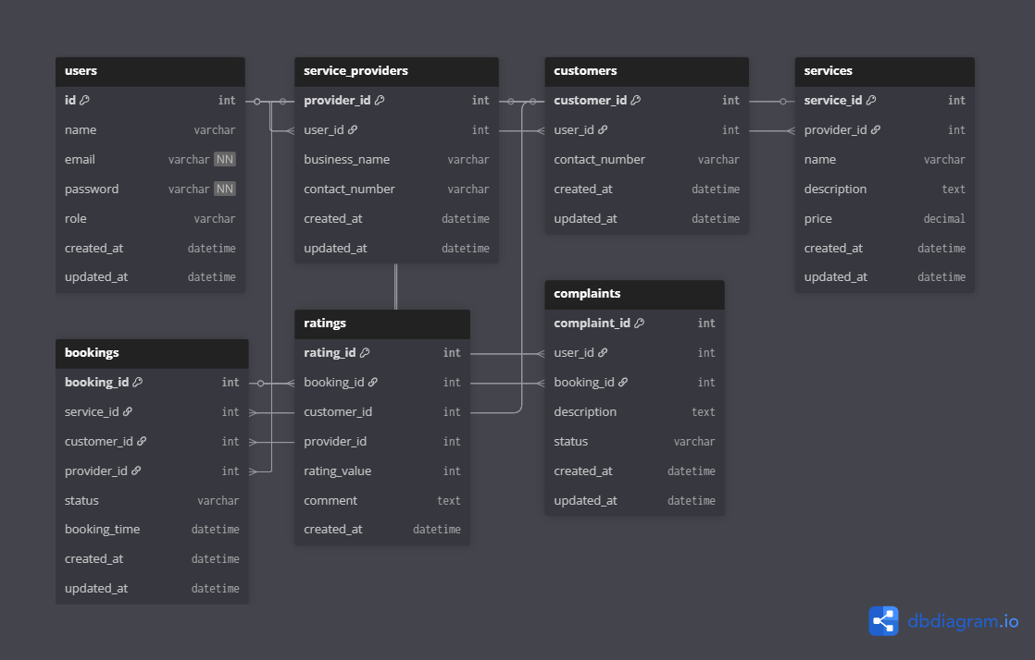
Database Schema Diagram

Slide 12
Backend & API Integration
The backend is powered by Flask, handling routing, authentication, and CRUD operations. APIs are integrated for features like user login, service creation, and booking. Flask-Login manages sessions, and SQLAlchemy handles ORM. The app exposes REST endpoints tested using Postman for performance and correctness.

Slide 13
Testing Framework and API Testing
API and functional testing were performed using Postman to verify endpoints such as login, registration, and service booking. Flask’s built-in test client and assertions were also used to simulate user interactions. Each test ensured that responses, status codes, and database updates worked as expected before deployment.
Testing was done to verify that all features in the application work correctly and handle errors properly.
We used Postman to test all Flask API routes such as Register, Login, Booking, Complaints, and Admin Dashboard.
Each endpoint was tested for correct request type (GET/POST) and response status codes (200, 302, 400, etc.).
Verified that data flows correctly between frontend, backend, and database.
Flask’s built-in framework testing ensured routes, sessions, and database operations run smoothly.
Overall testing improved performance, reliability, and user experience of the application.

Slide 14
Hosting the Web Application
The project was deployed on Render, a cloud hosting platform. The backend runs using Gunicorn for production-grade performance. The database (local_services.db) is initialized automatically on deployment. Render allows live URL access, continuous deployment from GitHub, and scalability for real-time user interaction.

Slide 15
Conclusion
LocalLink demonstrates how modern full-stack applications integrate backend logic, frontend UI, and database operations into one cohesive system. The use of Git, UML diagrams, API testing, and cloud hosting showcases professional software engineering workflow, making it a complete academic and practical project.

